Slide 1

Bio-Medical Waste Rules, Agencies, and Global Agreements
Information Security Fundamentals | Environmental Laws and Regulation
Course: Information Security Fundamentals | Chapter: Environmental Laws and Regulation | Program: Bachelor of Engineering
DISCOVER · LEARN · EMPOWER
Notes:
Welcome everyone to this advanced session on Environmental Laws. Today we dive deep into the Bio-Medical Waste Rules of 1998 and the critical roles of our legal and police agencies. We will also explore how international protocols like Montreal and Kyoto shape our local responsibilities. Remember, this is about securing our planet through innovation and strict adherence to law.

Slide 2
Course Outcomes
SLIDE 2 / 14
Course Outcome
CO | BT LEVEL | DESCRIPTION
CO1 | BT4 | Recall, analyze and respond on fundamental environmental principles, such as ecological relationships and conservation strategies
CO2 | BT4 | Understand and analyze the interconnections between human activities and environmental impacts across different ecosystems
CO3 | BT4 | Understand and analyze and apply environmental laws and policies to analyse and propose solutions for real-world environmental challenges.
CO4 | BT2 | Students will analyse data from environmental monitoring programs to assess trends and predict future impacts on ecosystems.
CO5 | BT6 | Interpret, elaborate and propose various tools, design and innovative strategies for sustainable development and environmental conservation initiatives in securing the planet.
Chandigarh University
2 / 14
Notes:
Our primary focus for this lecture is Course Outcome 5. You must be able to interpret complex regulations and propose innovative strategies for environmental conservation. This means moving beyond just knowing the rules to designing solutions that secure our planet. We will apply this by analyzing how CSR and legal frameworks drive sustainable practices.

Slide 3
Learning Objectives
SLIDE 3 / 14
Learning Outcomes
1
Analyze the classification and handling protocols of Bio-Medical Waste Rules, 1998.
2
Evaluate the enforcement roles of magistracy, courts, and police in environmental protection.
3
Critique the impact of Montreal and Kyoto protocols on global environmental policy.
4
Propose Corporate Social Responsibility strategies for waste management and sustainability.
5
Synthesize legal frameworks to design innovative conservation initiatives for the future.
Chandigarh University
3 / 14
Notes:
By the end of this lecture, you will analyze the specific waste categories defined in the 1998 rules. You will evaluate how the magistracy and police enforce these laws in real-world scenarios. We will also critique how international agreements influence our national policies. Finally, you will propose CSR strategies that integrate these legal requirements into business models.

Slide 4
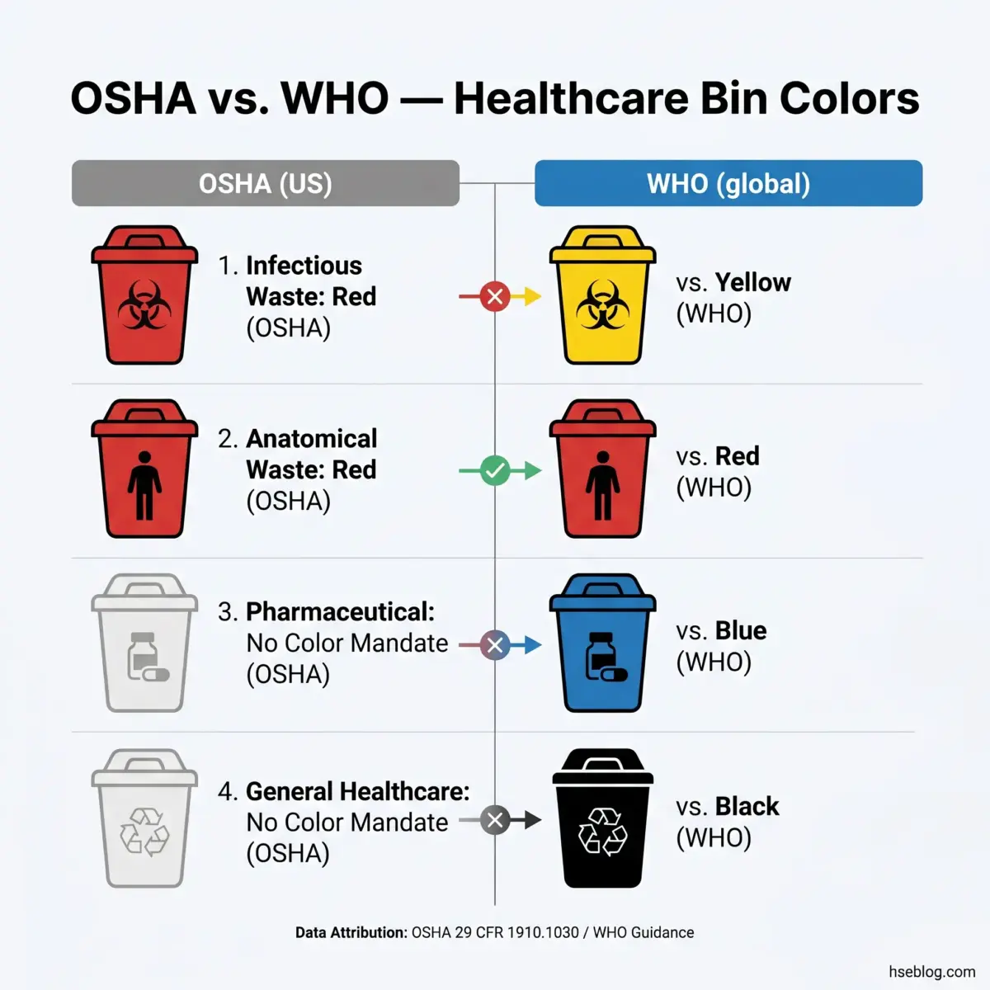
Lecture
SLIDE 4 / 14
Bio-Medical Waste Rules 1998 Overview
1
The Rules classify waste into four distinct categories based on color coding.
2
Yellow bags contain human anatomical waste and soiled items requiring incineration.
3
Red bags are for contaminated plastics and rubber items needing autoclaving.
4
White containers hold sharps like needles and scalpels for safe disposal.
5
Blue bags collect pharmaceutical and chemical waste for specialized treatment.
6
Mandatory segregation at the point of generation prevents cross-contamination risks.
Recycling Bin Color Codes: What Each Color Means (2026)
Chandigarh University
4 / 14
Notes:
The 1998 Rules revolutionized hospital waste management by mandating strict segregation. For instance, mixing needles with general waste is a critical failure. The color coding is not arbitrary; yellow is for incineration, red for autoclaving, and white for sharps. This segregation is the first line of defense against infection and environmental toxicity.

Slide 5
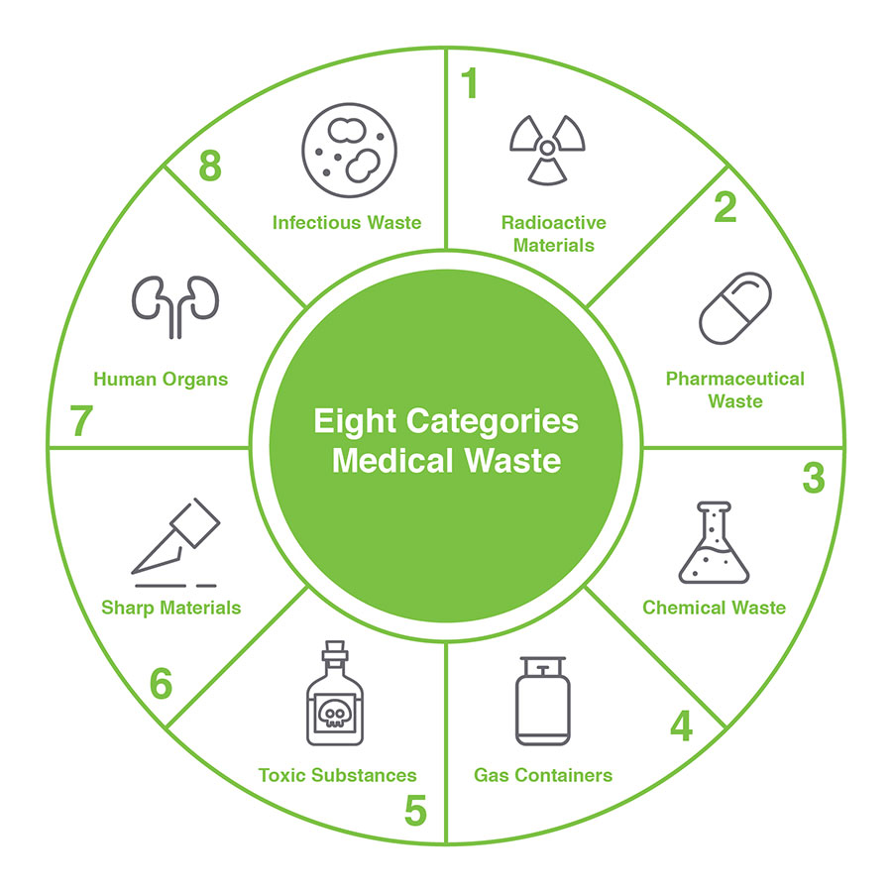
Lecture
SLIDE 5 / 14
Role of Magistracy in Enforcement
1
Magistrates issue orders under Section 144 to stop illegal waste dumping immediately.
2
They have the authority to seize vehicles and equipment used for violations.
3
Judicial oversight ensures that local bodies comply with disposal timelines strictly.
4
Magistrates can impose fines on hospitals failing to maintain waste records.
5
Their intervention prevents health hazards by ordering immediate remediation of sites.
6
Legal action by magistrates creates a deterrent effect against negligent disposal practices.
What Role Does The CDC Have With Medical Waste Management (source: www.securewaste.net)
Chandigarh University
5 / 14
Notes:
The magistracy acts as the immediate enforcer on the ground. If a hospital dumps waste illegally, a magistrate can issue a Section 144 order to stop it instantly. They can also seize the trucks used for dumping. This judicial power ensures that environmental laws are not just paper promises but actionable mandates.

Slide 6
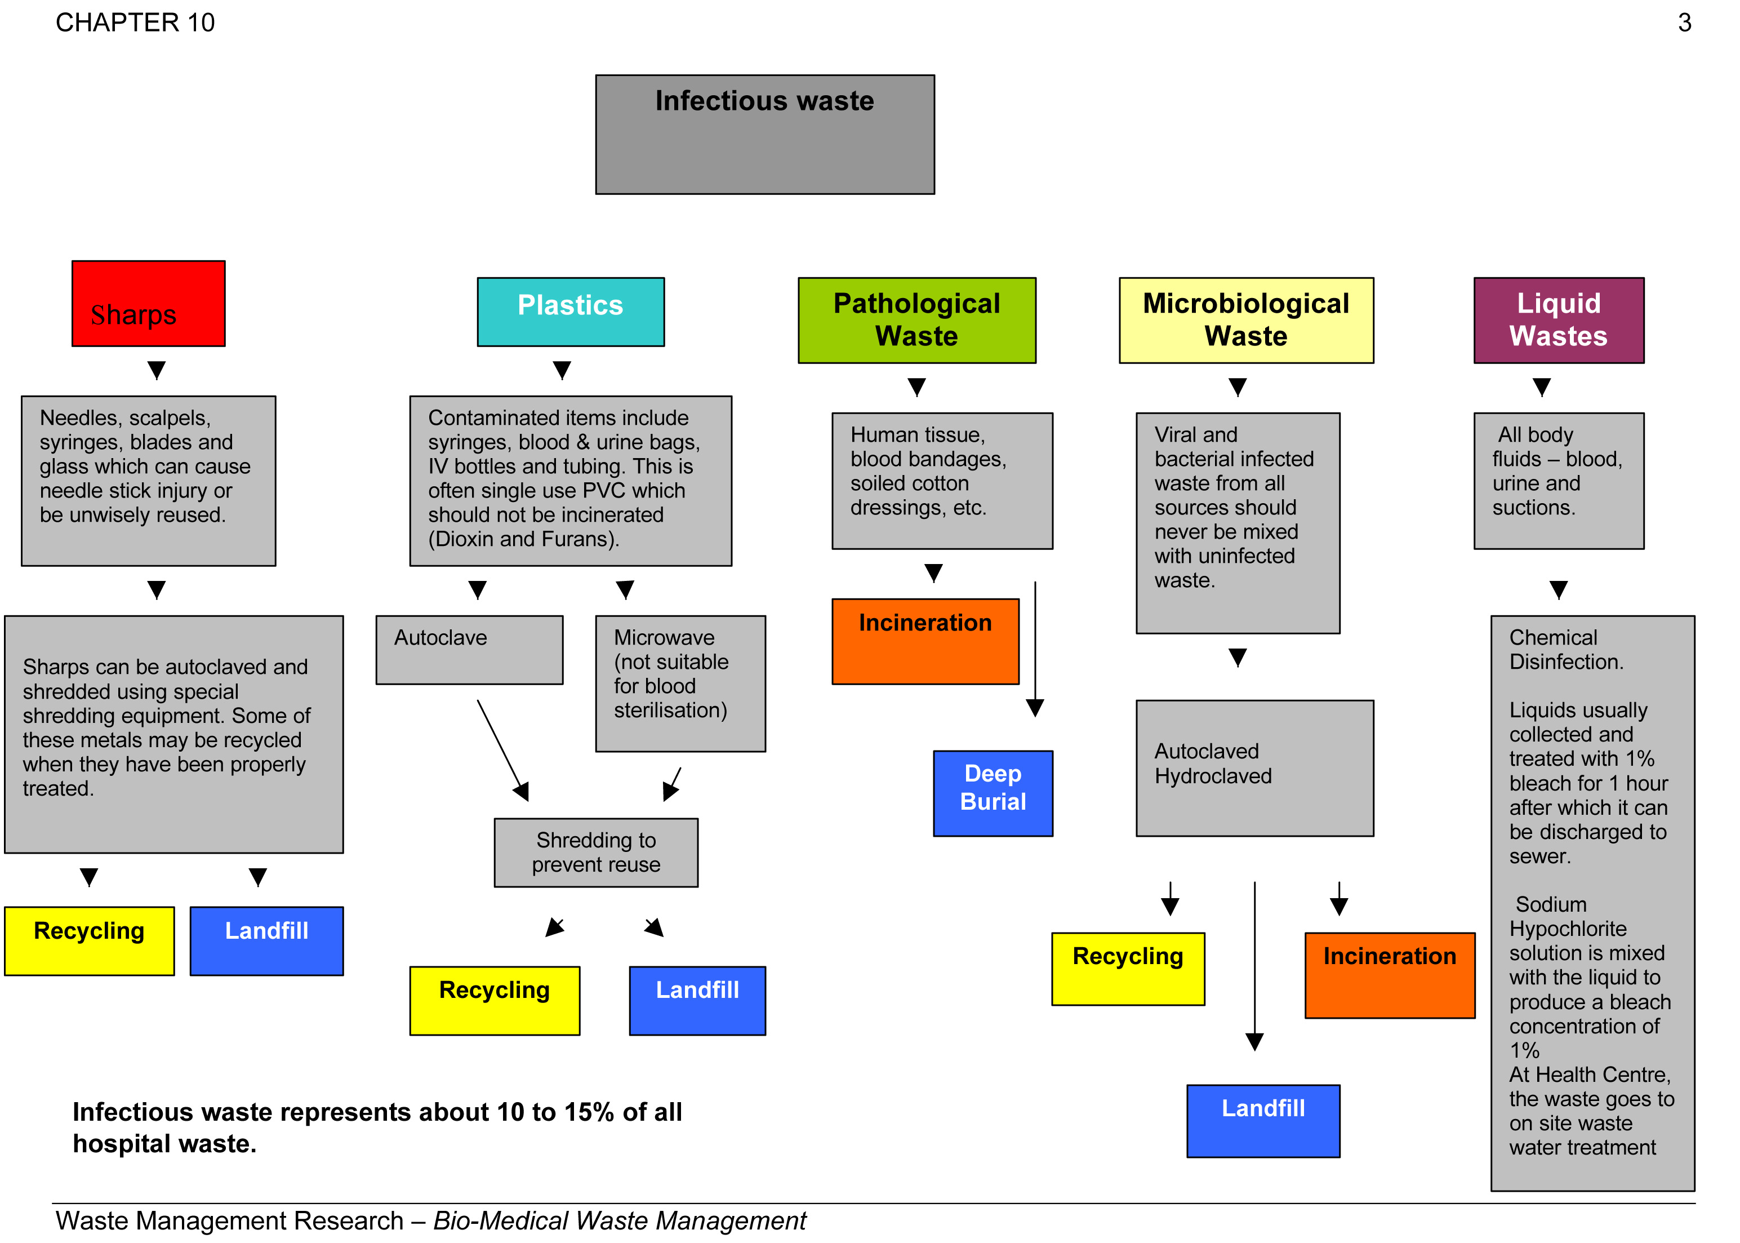
Lecture
SLIDE 6 / 14
Role of Higher Courts and Police
1
Higher courts interpret ambiguous laws to set binding precedents for all states.
2
Police enforce the rules by registering FIRs for criminal negligence in waste handling.
3
Courts can order compensation for environmental damage caused by medical waste.
4
Police raids on unauthorized disposal sites ensure compliance with safety standards.
5
Judicial activism in higher courts drives stricter penalties for repeat offenders.
6
Collaboration between police and courts ensures swift justice for environmental crimes.
BIOMEDICAL WASTE MANAGEMENT :AN INSIGHT | A VOICE IN THE WILDERNESS (source: aashim.wordpress.com)
Chandigarh University
6 / 14
Notes:
While magistrates handle immediate orders, higher courts provide the legal framework through precedents. Police play a crucial role by registering FIRs for criminal negligence. For example, if a hospital dumps waste causing a disease outbreak, the police can arrest the responsible manager. This collaboration ensures that environmental crimes are treated as serious offenses.

Slide 7
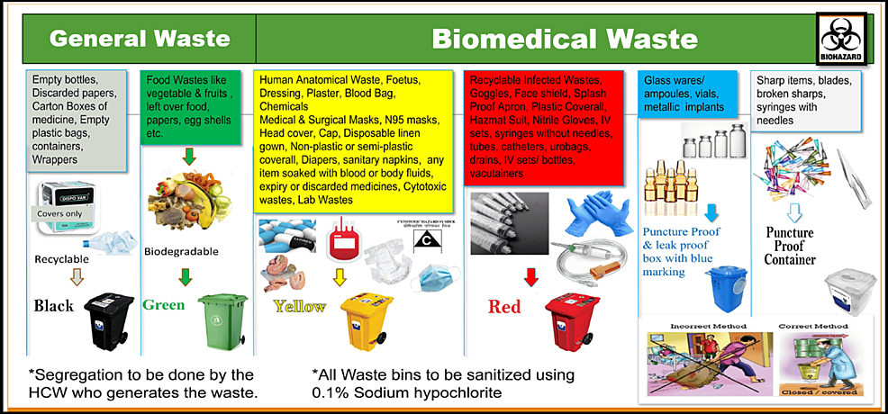
Montreal Protocol
SLIDE 7 / 14
Ozone Protection
1
The protocol mandates the phase-out of ozone-depleting substances like CFCs.
2
It requires nations to reduce production and consumption of controlled chemicals.
3
Success is measured by the recovery of the ozone layer over time.
4
Medical devices using CFCs must be replaced with ozone-friendly alternatives.
5
The protocol demonstrates global cooperation for a specific environmental threat.
6
Compliance ensures that medical refrigeration does not harm the atmospheric layer.
Exploring Biomedical Waste Management Practices Among Healthcare Professionals: A Study From a Tertiary Care Teaching Hospital in Eastern
Chandigarh University
7 / 14
Notes:
The Montreal Protocol is a landmark agreement specifically targeting ozone-depleting substances. It requires us to phase out CFCs used in medical refrigeration and aerosols. The success of this treaty is evident in the thinning of the ozone hole. This shows how international law can directly protect our atmosphere from industrial and medical byproducts.

Slide 8
Kyoto Protocol
SLIDE 8 / 14
Greenhouse Gases
1
The protocol sets binding targets for reducing greenhouse gas emissions globally.
2
It introduces mechanisms like carbon trading to achieve emission reductions cost-effectively.
3
Medical waste incineration contributes to emissions and must be controlled under this.
4
Nations must report their emission inventories to ensure transparency and accountability.
5
The protocol links economic development with the necessity of climate action.
6
Failure to comply results in international pressure and potential trade restrictions.
BIOMEDICAL WASTE MANAGEMENT :AN INSIGHT | A VOICE IN THE WILDERNESS (source: aashim.wordpress.com)
Chandigarh University
8 / 14
Notes:
The Kyoto Protocol addresses the broader issue of climate change through binding emission targets. It introduces carbon trading, allowing entities to buy and sell emission credits. For us, this means managing waste incineration to minimize greenhouse gas output. Compliance is not optional; it is a global economic and environmental necessity.

Slide 9
Lecture
SLIDE 9 / 14
Convention on Biological Diversity (CBD)
1
The CBD aims to conserve biological diversity and promote sustainable use.
2
It requires nations to prevent the introduction of invasive alien species.
3
Medical waste can harm local ecosystems if not disposed of properly.
4
The protocol emphasizes the fair sharing of benefits from genetic resources.
5
It mandates national strategies to integrate biodiversity into all sectors.
6
Protecting biodiversity ensures the resilience of ecosystems against pollution.
Chandigarh University
9 / 14
Notes:
The Convention on Biological Diversity focuses on conserving the variety of life on Earth. It requires us to prevent invasive species and protect local ecosystems from pollution. Improper medical waste disposal can destroy local habitats and harm biodiversity. This agreement ensures that our development does not come at the cost of ecological collapse.

Slide 10
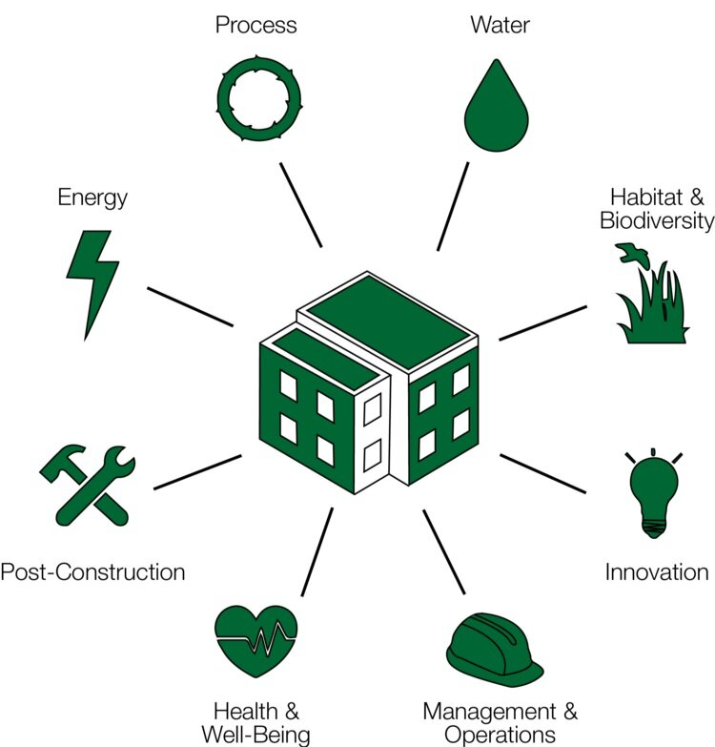
Lecture
SLIDE 10 / 14
Corporate Social Responsibility (CSR)
1
CSR mandates companies to contribute to environmental sustainability and social welfare.
2
Hospitals must invest in waste treatment facilities as part of their CSR.
3
Funds can be allocated for community awareness programs on waste segregation.
4
CSR initiatives enhance brand reputation and ensure regulatory compliance.
5
Companies must report their environmental impact in annual sustainability reports.
6
Strategic CSR turns regulatory compliance into a competitive advantage for growth.
Source: images.squarespace-cdn.com
Chandigarh University
10 / 14
Notes:
Corporate Social Responsibility is not just charity; it is a strategic imperative. Hospitals must invest in proper waste treatment facilities as part of their CSR obligations. They can also fund community awareness programs to teach proper segregation. This transforms regulatory compliance into a brand asset, showing the public that the company cares.

Slide 11
Worked Example
SLIDE 11 / 14
Waste Cost Analysis
GOVERNING EQUATION
Total waste generated = 500 kg/month; Segregation cost = ₹20/kg
1
Incineration cost for yellow waste = ₹50/kg; Autoclave cost = ₹30/kg.
2
Improper disposal fine = ₹50,000 per violation; Compliance saves ₹10,000/month.
3
Total monthly cost = (500 × 20) + (200 × 50) + (300 × 30) = ₹31,000.
4
With CSR investment, cost reduces by 15% due to efficiency gains.
5
Net savings = ₹4,650/month; ROI achieved in 6 months.
Exploring Biomedical Waste Management Practices Among Healthcare Professionals: A Study From a Tertiary Care Teaching Hospital in Eastern
Chandigarh University
11 / 14
Notes:
Let's look at a numerical example. If a hospital generates 500 kg of waste, proper segregation costs ₹20 per kg. Incineration for yellow waste is ₹50 per kg, while autoclaving is ₹30. Without proper management, a fine of ₹50,000 could wipe out a year's profit. By investing in CSR, they save ₹4,650 monthly, achieving ROI in just six months.

Slide 12

Lecture
SLIDE 12 / 14
Common Pitfalls in Implementation
1
Mixing different waste categories leads to increased treatment costs and risks.
2
Lack of training for staff results in incorrect color-coding of bags.
3
Ignoring record-keeping requirements invites legal action from regulatory bodies.
4
Underestimating the volume of waste leads to overflow and spillage.
5
Failing to update protocols for new medical technologies creates compliance gaps.
6
Neglecting community engagement reduces the effectiveness of awareness campaigns.
Source: static.vecteezy.com
Chandigarh University
12 / 14
Notes:
Common pitfalls include mixing waste categories, which increases treatment costs and risks. Lack of training often leads to incorrect color-coding, rendering the system useless. Ignoring record-keeping is a major legal risk. We must also update protocols for new technologies and engage the community to ensure long-term success.

Slide 13
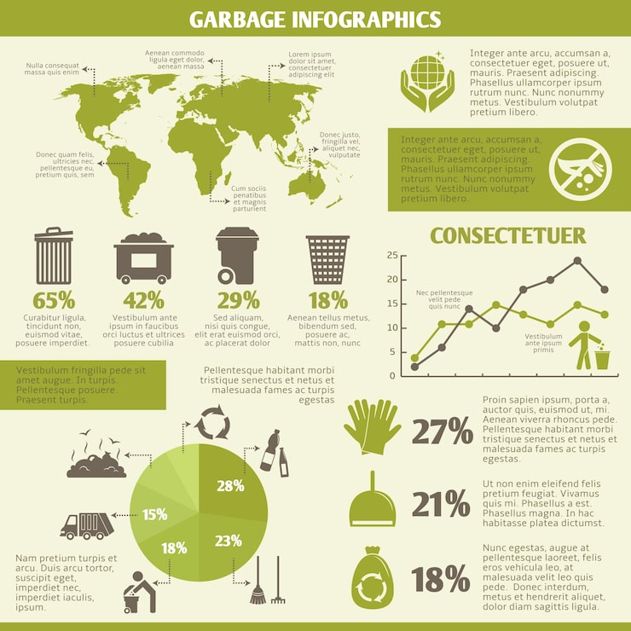
Lecture
SLIDE 13 / 14
Key Takeaways
1
Bio-Medical Waste Rules 1998 mandate strict segregation and color-coded disposal.
2
Magistracy and police enforce laws through immediate orders and criminal penalties.
3
Montreal and Kyoto protocols drive global reduction of ozone and greenhouse gases.
4
CBD ensures biodiversity conservation against pollution and invasive species.
5
CSR transforms regulatory compliance into a strategic advantage for sustainability.
Source: img.magnific.com
Chandigarh University
13 / 14
Notes:
To summarize, the 1998 Rules require strict segregation to prevent contamination. The magistracy and police are the enforcers, ensuring compliance through legal action. International protocols like Montreal and Kyoto guide our global responsibilities. Finally, CSR turns these legal requirements into a strategic advantage for sustainable development.

Slide 14
Lecture
SLIDE 14 / 14
References
ENVIRONMENTAL STUDIES
From Crisis to Cure — R. Rajagopalan
• Environmental Science and Engineering — Benny Joseph
• Environmental Studies — R.C. Sharma and D. Gurbir Sangha
• Introduction to Environmental Science — Anjaneyulu, Y.
• Environmental Pollution Control Engineering — C.S. Rao
• Textbook of Environmental Studies for undergraduate courses — E. Bharucha
• Environmental Science — S.C. Santra
Chandigarh University
14 / 14
Notes:
These references provide the foundational knowledge for the topics discussed today. Benny Joseph and R.C. Sharma offer detailed insights into environmental laws. Anjaneyulu and C.S. Rao provide technical details on pollution control. E. Bharucha and R. Rajagopalan offer broader perspectives on sustainability. S.C. Santra's work complements these with scientific rigor.

